Slide 1
Employee Data Analysis using Excel
STUDENT NAME: SANDHIYA A
REGISTER NO: 312209346
DEPARTMENT: B. COM ( GEN) COMMERCE
COLLEGE: ANNA ADARSH COLLEGE FOR WOMEN
NAAN MUDHALVAN ID: asunm1353312209346

Slide 2
PROJECT TITLE
Employee Performance Analysis using Excel

Slide 3


AGENDA
Problem Statement
Project Overview
End Users
Our Solution and Proposition
Dataset Description
Modelling Approach
Results and Discussion
Conclusion
3/21/2024 Annual Review

Slide 4

PROBLEM STATEMENT
To Analyse and optimize the performance of the employees by evaluating the key option such as emplyoee id, emplyoee status, emplyoee level and the employee performance rating, etc.
This analysis helps to identify the emplyoee according to their performance whether it is Very High, High, Medium or Low.

Slide 5

PROJECT OVERVIEW
The overall objective of the project is to create a performance analysis using excel by using the various functions such as
Conditional formatting.
Inserting Pivot table
Chart showing the analysis.

Slide 6

WHO ARE THE END USERS?
Employers
Employees
Organisation

Slide 7

OUR SOLUTION AND ITS VALUE PROPOSITION
Conditional formatting : To highlight the missing Data.
Filtering : To remove the misssing data.
Pivot table : To summarise the data.
Chart : To get the graphical representation of thr analysis.

Slide 8
Dataset Description
Employee dataset : Kaggle
Total : 26 features
Used: 9 Features
Employee ID
First Name
Last name
Business unit
Employee Type
Gender
Performance score
Current Employee rating

Slide 9

THE "WOW" IN OUR SOLUTION
CONDITIONAL FORMATTING : The Conditional formatting is used to identify and highlight the missing cells. It further helped to remove those empty cells.
3/21/2024 Annual Review
9

Slide 10
MODELLING
DATA SCREENING : Downloaded the set from the kaggle website and Inserted in the excel.
DATA CLEANING : Using the conditional formatting removed the missing data.
PIVOT TABLE CREATION : Select the pivot table from the Insert and now the pivot table is enable. Now select the data to be shown in the pivot table.
GRAPHICAL REPRESENTATION : Now go to insert and select recommended chart or any chart type. Now the visual representation is created.
10

Slide 11
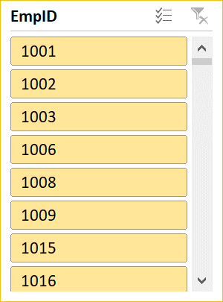
RESULTS
GenderCode | Female
Count of FirstName | Column Labels
Row Labels | HIGH | LOW | MED | VERY HIGH | Grand Total
BPC | 18 | 40 | 97 | 20 | 175
CCDR | 21 | 40 | 93 | 16 | 170
EW | 24 | 43 | 103 | 13 | 183
MSC | 19 | 39 | 98 | 13 | 169
NEL | 24 | 31 | 100 | 10 | 165
PL | 19 | 30 | 105 | 18 | 172
PYZ | 20 | 40 | 92 | 8 | 160
SVG | 24 | 42 | 89 | 20 | 175
TNS | 19 | 39 | 86 | 11 | 155
WBL | 19 | 37 | 90 | 12 | 158
Grand Total | 207 | 381 | 953 | 141 | 1682

Slide 12
conclusion
Employee performance analyses using various functions such as pivot table, graph etc.. Are created. This helps to quickly analyse the given data. It helps to find the employees with greater efficiency

